Slide 1
Financial Markets and Institutions
The capital allocation process;
Financial markets;
Types of financial markets;
Financial Institutions;
The stock market;
Stock market and returns;
Stock market efficiency

Slide 2
Financial Environment
Components:
Financial Market
Saving Surplus Units
Financial Market
Financial Market
Financial Intermediaries
Saving Deficit Units
Financial Market

Slide 3
Capital Allocation Process
On one hand:
Individual (5m needed have only 3m on hand)
Banks and financial institutions (increase paid of capital apart from retained earning)
Government (need funds to finance general and development activities)
Individuals, Business organization as well as government must rely on financial markets to raise required funds
On other hand:
Individual (income greater than saving)
Business organization(have surplus cash)
Government
Individuals, Business organization and Government with surplus cash also requires financial market
In well functioning financing system, saving generated by surplus unit are transferred to deficits unit for investment

Slide 4
Capital Allocation Process
Direct Transfers
securities (stock or bonds)
Funds
b. Indirect transfers through Investment Bankers
Securities Securities
Funds Funds
c. Indirect transfers through Financial Intermediary
Securities Securities
Funds Funds
Business
Savers
Business
Investment Bankers
Savers
Business
Financial Intermediary
Savers

Slide 5
Financial Market
The market which deals with transactions of financial instruments and services.
Bring buyer and seller of financial assets and services together
Brings lender and borrower of funds together with the help of financial intermediaries directly or indirectly.
“The financial markets channel saving which come mainly from households to those individuals and institutions who need funds for spending then are provided by current income” (Peter S. Rose)
Importance of Financial Markets:
Facilitate the trading of financial assets
Improve liquidity and help in price discovery of securities
Facilitate transformation of saving into investment
Satisfy financing need of Businesses and Households

Slide 6
Types of Financial Markets
Primary Market and Secondary Markets
Primary (Seasoned and unseasoned)
Secondary (Organized Exchange and Over the Counter )
2. Money Market and Capital Market
Spot Market and Future Market
Physical Assets Market and Financial Assets Market
National and International Market

Slide 7
Financial Institutions/ Intermediaries
Specialized firms dealing with financial services and facilitating transfer of funds from savers to users.
Acts as intermediaries between issuer of securities and investing people
Concern on structure and items of financial statements
Types of Financial Institutions / Intermediaries
Financial Institutions
Depository Institution
Non Depository Institution
Banks
Insurance Companies
Credit Unions
Pension Funds
Savings and Credit Associations
Brokerage Firms
Mutual Funds Companies

Slide 8
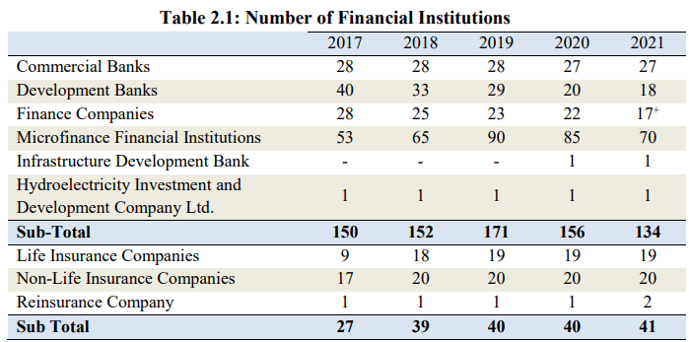
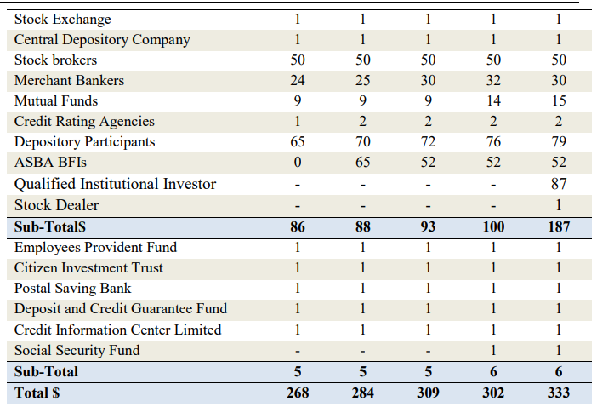
Growth of Financial Institutions in Nepal
As of mid July 2021

Slide 9
Role of Financial Institutions/ Intermediaries
Allocate Saving into Investment
Provide Financial Services
Provide Satisfactory Returns and Minimize Risk of loss
Help Business in Raising Funds

Slide 10
The Stock Market
Secondary market which aids to liquidity of securities traded thereon.
Provides necessary mobility to capital and directs the flow of capital into profitable and successful organization or companies
Classification of Stock Market
Primary Market
Secondary Market
Organized Stock Exchange
Over the Counter (OTC) market

Slide 11
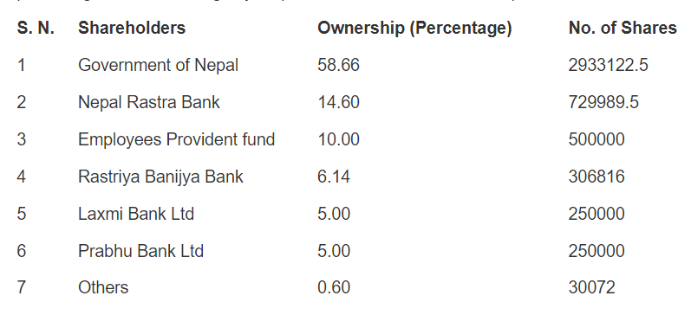
Nepal Stock Exchange
Organized Stock Exchange in Nepal
Nepal Stock Exchange, in short NEPSE, is established under the Companies Act- 2006, operating under Securities Act- 2007. The basic objective of NEPSE is to impart free marketability and liquidity to the government and corporate securities by facilitating transactions in its trading floor through member, market intermediaries, such as broker, market makers etc. NEPSE opened its trading floor on13th January 1994
The current paid-up capital of NEPSE is NRs.50,00,00,000.

